Slide 1


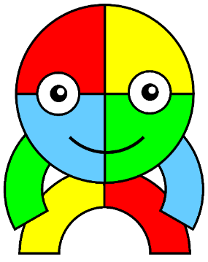

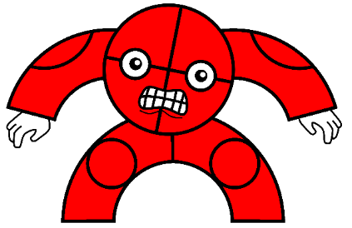
Assembly

Slide 2
Who is hiding?
What does reflective mean?

Slide 3
Reflective
To think about something.

Slide 4
Being reflective at Allenton
Thinking about what I have done; what I like and how I can improve it.

Slide 5
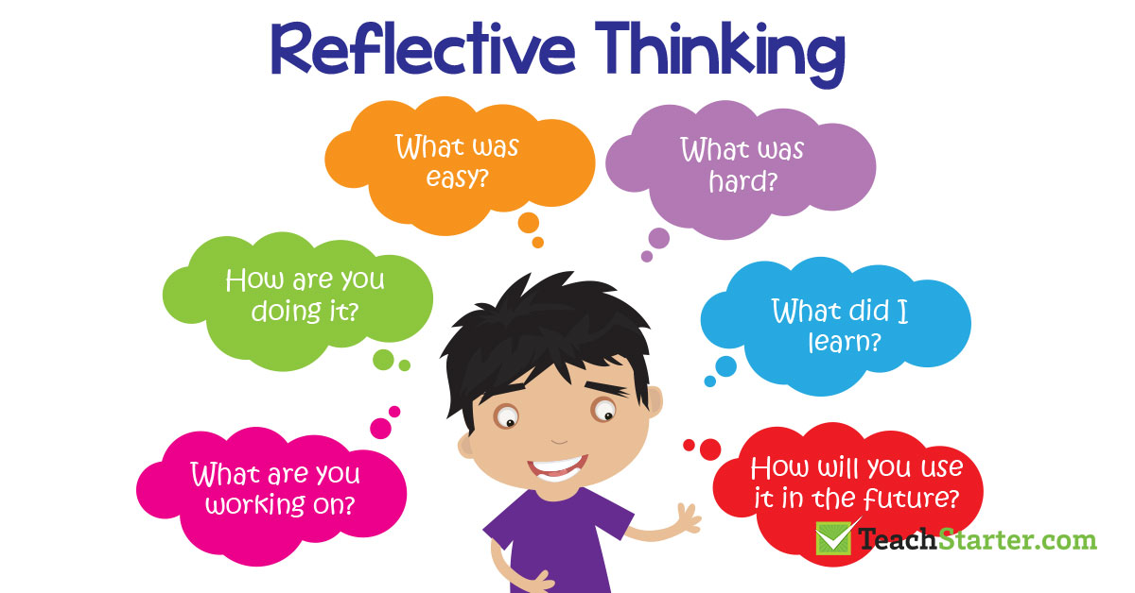


Slide 6

Can you think of a time when you have been reflective?

Slide 7




Slide 8
Did she use any of our other superheroes?

