Slide 1


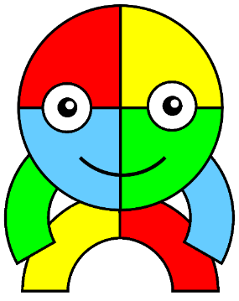


Assembly

Slide 2
Who is hiding?
What does resourceful mean?

Slide 3
Resourceful
Having the ability to find quick and clever ways to overcome difficulties.

Slide 4
Being resourceful at Allenton
Being able to use a range of learning strategies and knowing what to do when you get stuck.

Slide 5
How can we be resourceful?
What can we use?

Slide 6
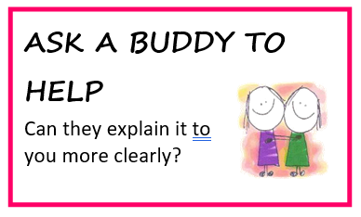
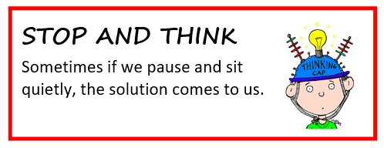
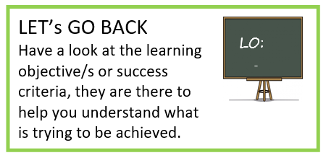
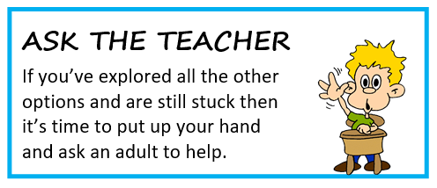
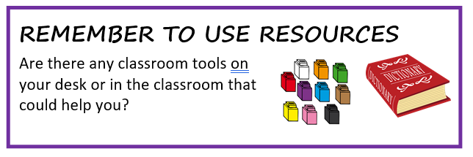
Resourceful

Slide 7
Can you think of examples of when you have been resourceful?

Slide 8



Resourceful

