Slide 1


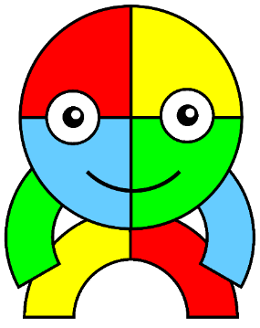

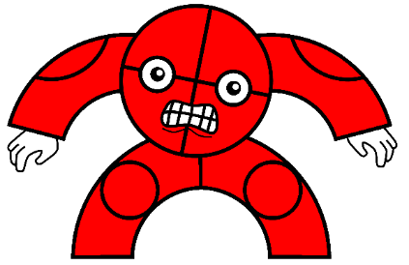
Assembly
11th February 2022

Slide 2
Who is hiding?
What does reciprocity mean?

Slide 3
Reciprocity
The process of working collaboratively in order to achieve a goal.

Slide 4
What are the advantages
of working together?

Slide 5
Reciprocity
By working together we can:
  Achieve something we cannot do alone
  Complete something more quickly
  Negotiate and compromise with others
  Support those who are finding it difficult

Slide 6
What skills do we need
when working together?

Slide 7
Reciprocity
Good communication
Good listening
Taking turns
Problem solving
Thinking about each others strengths
Encouraging each other

Slide 8
Can you think of examples
of working together?

Slide 9

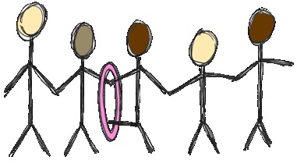

Reciprocity

Slide 10
Reciprocity
Together
Everyone
Achieves
More

