Slide 1


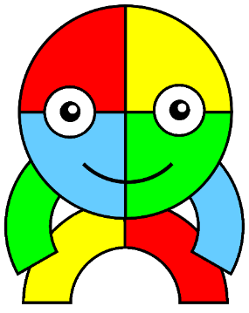
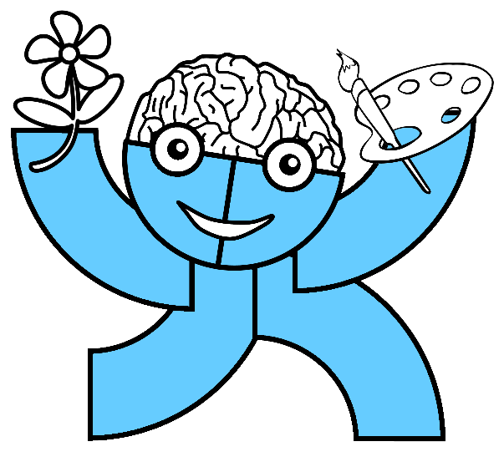
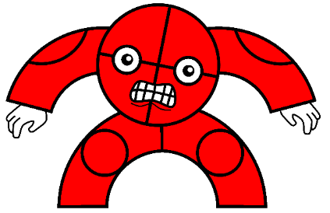
Assembly
20th January 2022

Slide 2
Who are these?
Write in the chat

Slide 3
What does
resilience mean?

Slide 4
Resilience
The capacity/ability to recover quickly from difficulties, and tough situations.

Slide 5
Why might we
need resilience?

Slide 6
Resilience
School can be a tough place sometimes
  Bad lesson
  Did not do as well as you wanted to in your work
  One of those days when nothing goes well
  Worrying about upcoming tests

Slide 7
Resilience
Opportunities to learn. We learn what doesn’t work.
A chance to reflect, refine and change our plans.
Develop resilience. We will handle difficulties with greater confidence if we can manage this one.
Setbacks enable us to understand other people’s experiences better – we all face setbacks.

Slide 8
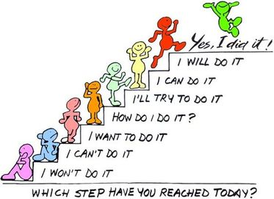

Resilience
All of these things can knock our confidence and it is our resilience that will enable us take these issues in our stride and progress forward, rather than getting moody about it.

Slide 9
Resilience
How many times does she fall over?
https://www.youtube.com/watch?v=VLq3kV55ESw

Slide 10
Resilience
There are things we can do to help improve our resilience.
Laugh it off – we all make mistakes.
Ask for help – if you’re finding it tricky.
Stay positive – tomorrow is a new day.
Relax – we can’t always be in control.
Take a break – come back to it later.

Slide 11

By using these tips as a school, we can be resilient in the face of problems as either individuals or a group.

