Slide 1






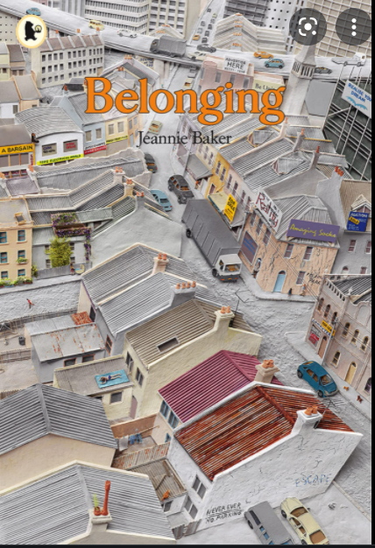


Street Detectives
Book Spine
Autumn 1 2020-21
Year 1

