Slide 1










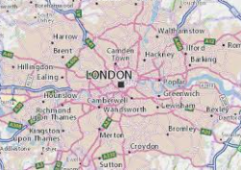

Whole class Read

