Slide 1
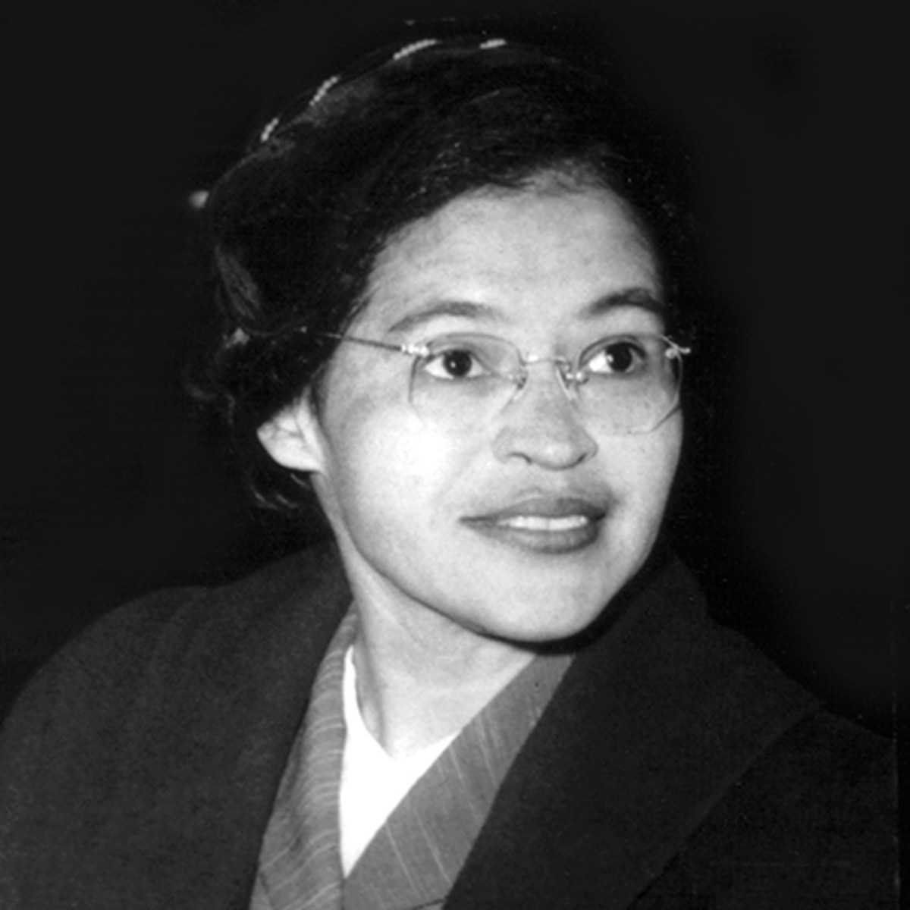
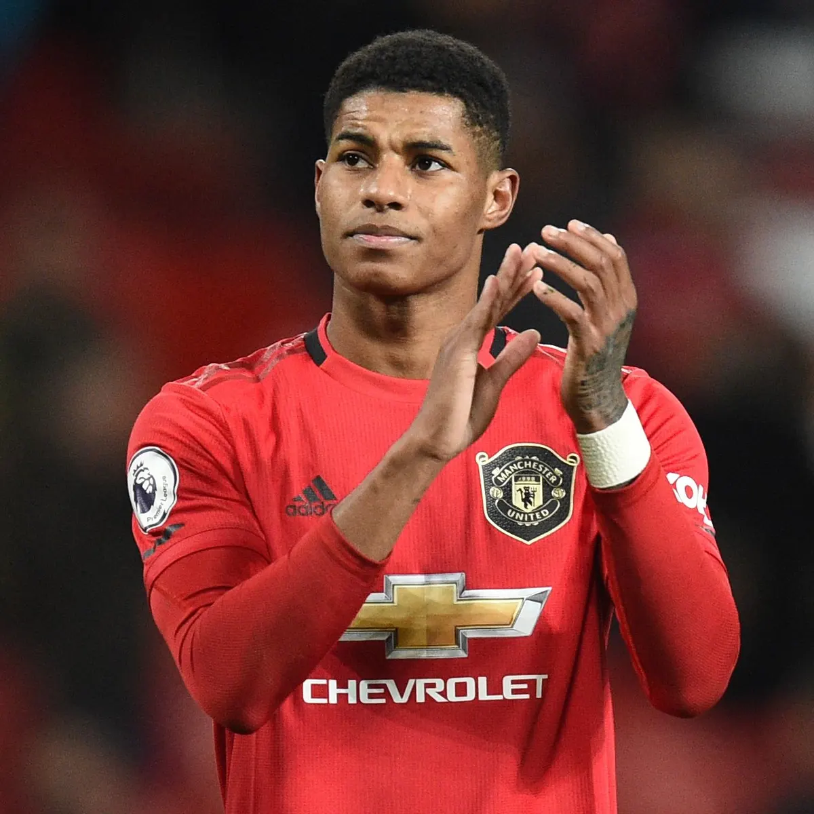
Significant People
Year 2
Autumn 2 2021

Slide 2











History Year 2 – Significant People

